Slide 1
CONTROL STATEMENS
if, if-else, nested if, if-else-if ladder
Ternary Operator
Switch case Statements

Slide 2
Java IF & IF ELSE Statement
If the condition is true
then do something
else do nothing
If the condition is true
then do something
else d0 something else
if (condition) {
//execute the code if condition is true
} else {
//execute the code if condition is false
}
if(condition) {
//Execute the code
}

Slide 3
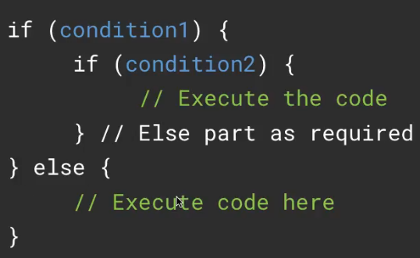
NESTED IF

Slide 4
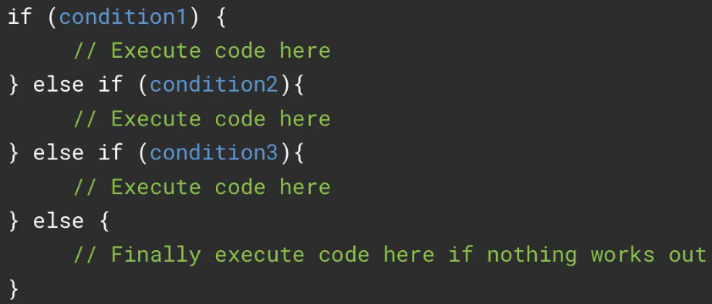
IF ELSE IF LADDER Keep on checking the condition one by one

Slide 5
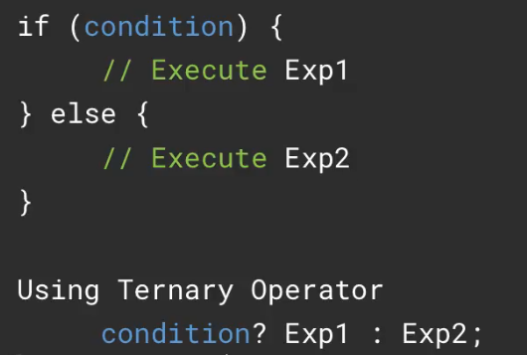
TERNARY OPERATOR Similar to if-else but we can simplify the syntax

Slide 6
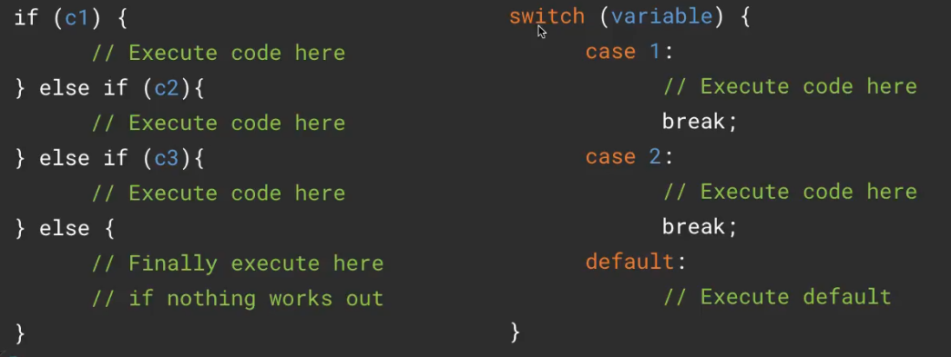
Switch case Statement Similar to IF-ELSE-IF ladder statement

Slide 7
Variables used in switch case can be:
Integer
Character
Byte
String
Enum

Slide 8
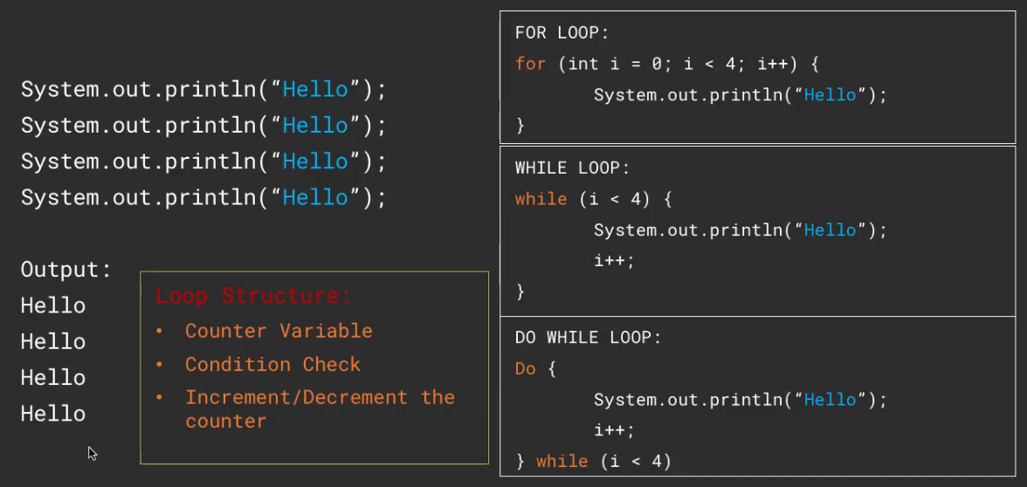
ITERATORS IN JAVA

Slide 9
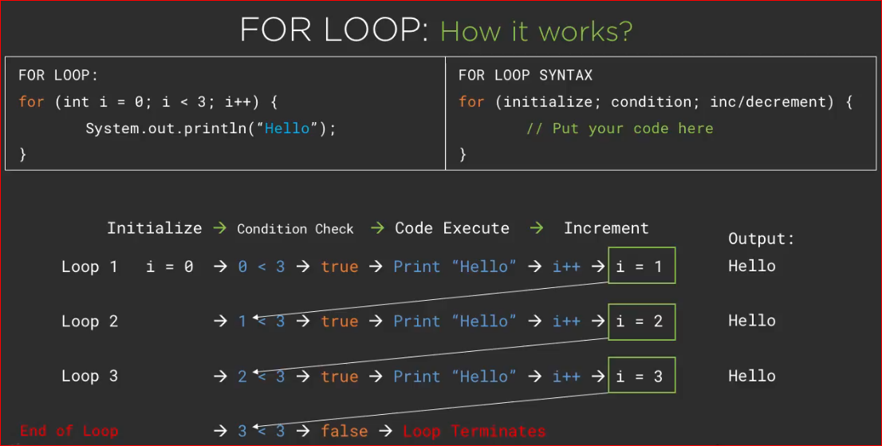

Slide 10
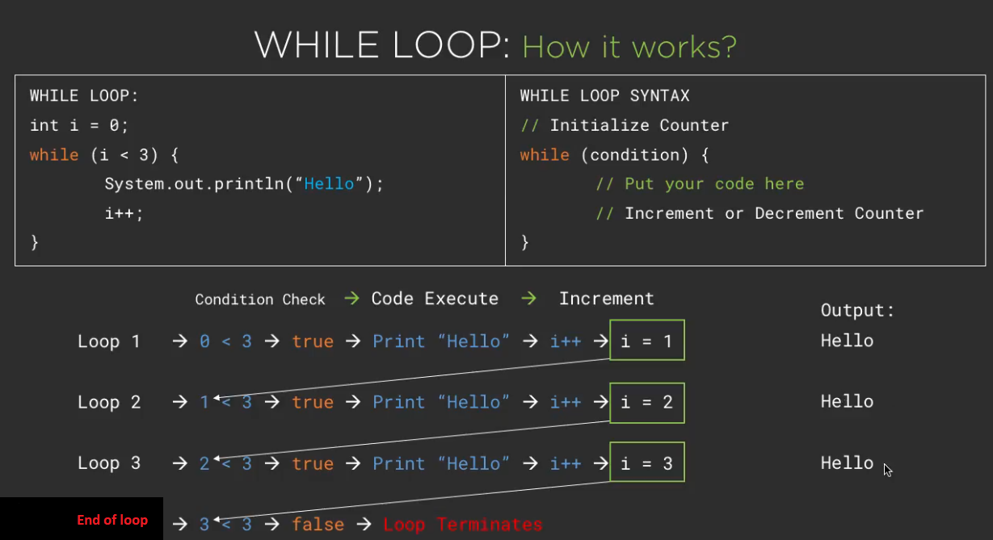

Slide 11
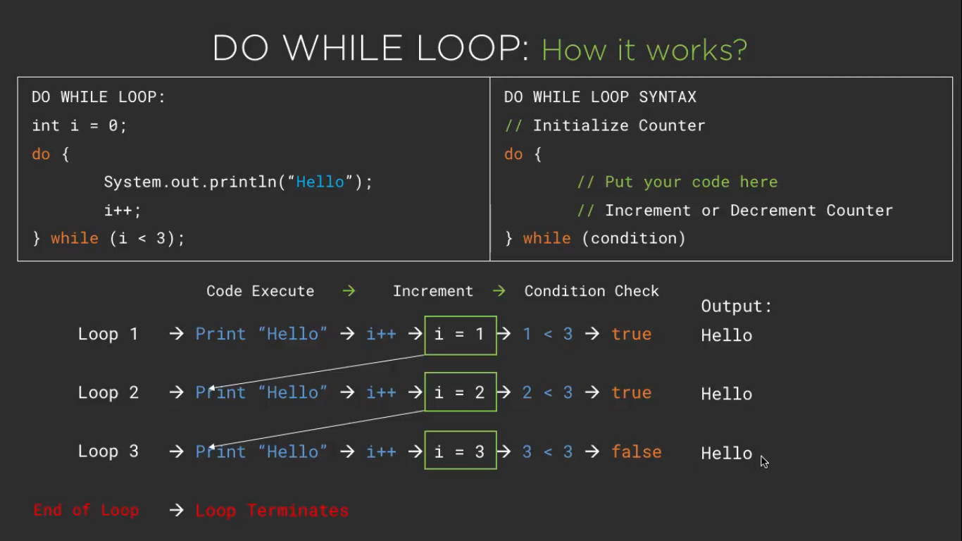

Slide 12
BREAK & CONTINUE
BREAK Statement Used to break the loop or switch case statements
CONTINUE Statement
Used to skip some code within the loop

Slide 13
EXAMPLES

